Slide 1
INTRODUCTION TO DATABASE MANAGEMENT SYSTEM (IDMS)
Lecture 3
Barnali Goswami

Slide 2
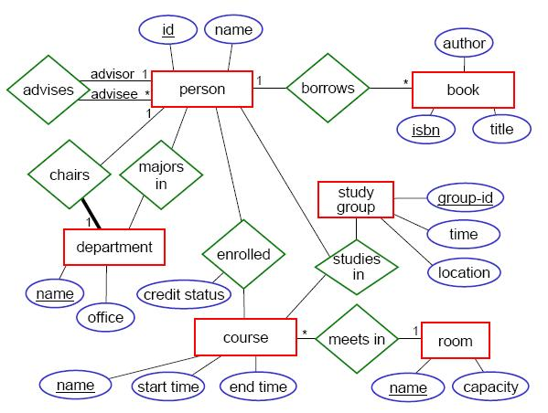
Entity-Relationship Model

Slide 3
Entity
An object or 'thing' in the real world,
With an independent existence,
Distinguishable from others.

Slide 4
Other terms related to entity
Entity Set: Collection of similar entities.
Attributes: Properties describing an entity.
Entity type: Collection of entities of similar attributes.

Slide 5
Types of Attributes
Simple (Atomic) & Composite Attributes
Simple attribute- not divisible into subparts.
Composite attribute- divisible to smaller subparts.

Slide 6
Types of Attributes
Single-valued & Multivalued Attributes
Single valued attribute- having single value for an entity.
Multivalued attribute- may have more than one values per entity.

Slide 7
Types of Attributes
Stored & Derived Attributes
Stored attribute- to be given directly.
Derived attribute- may be calculated from existing attribute.

Slide 8
Other terms related to attributes
Domain/Value set: set of permitted values for an attribute.
Key: a minimal set of attributes that uniquely identify an entity.

Slide 9
Types of Keys
Superkey: a set of one or more attributes allow to identify uniquely an entity in the entity set.
Candidate key: minimal superkey for which no proper subset is a superkey.
Primary key: a candidate key selected by the database designer.

Slide 10
Relationship
Association between two or more entities.
Relationship Set: set of similar relationships.
{(e1,...,en) | e1 ϵ E1,...,en ϵ En}
en is the entity belonging to entity set En.

Slide 11
Other terms related to relationship
Participation: association between entity sets.
Relationship schema: represents association between the entities in the real world that is being modeled. Snapshot of the relationship set at an instance.
Descriptive attributes: information about the relationship instead of participating entities.

Slide 12
Constraints in relationships
Mapping Cardinalities
Participation Constraints

Slide 13
Mapping Cardinalities
Number of entities to which another entity can be associated in a relationship set.
Useful in binary relationship sets.
Types: One to One
              One to Many
              Many to One
              Many to Many

Slide 14
Participation Constraints
Total: every entity in E participates in at least one relationship in R.
Partial: only some entities of e participate in R.

Slide 15
E-R Diagram
Expresses the overall logical structure of a database graphically

Slide 16
Weak Entity Set
Entity set that do not have sufficient attributes to form a primary key.
Entity set that has a primary key is called strong entity set.
Weak entity set has to be associated with a strong entity set, called identifying/owner entity set.
Weak entity set is existent dependent on the identifying entity set.

Slide 17
Weak Entity Set
Relationship between the weak entity set and identifying entity set is called identifying relationship.
This relationship is many-to-one from weak to identifying.
And its a total relationship from weak to identifying.
Primary key of weak entity set = Primary key of identifying entity set + weak entity set's discriminator.

Slide 18
Specialization
An entity set is broken down into subgroups.
Because may be in an entity set, a subset of entities may have attributes that are not shared by all the entities of the set.
Employs top down approach.
An entity set may be specialized by more than one distinguishing features.

Slide 19
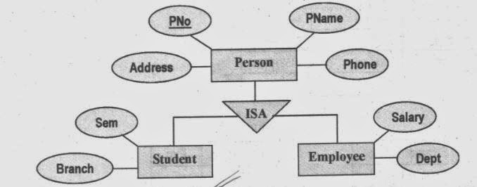
Specialization

Slide 20
Generalization
Same as specialization but employs bottom up approach.
Multiple entities are grouped on the basis of common features.

Slide 21
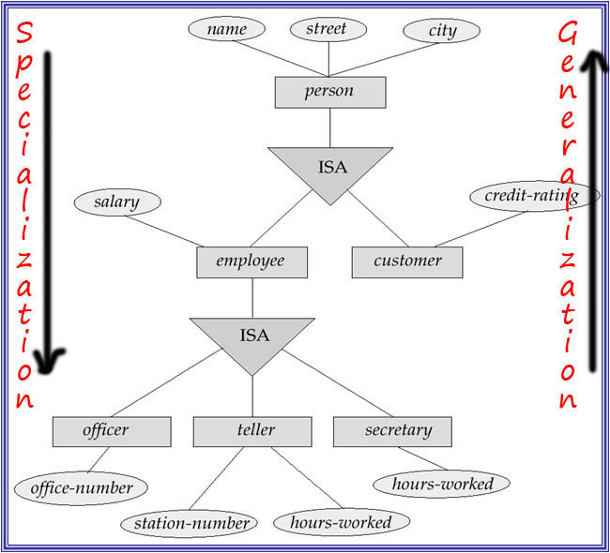

Slide 22
Constraints on Generalization
Membership constraint: regarding membership of entities in an entity set.
a) Condition-defined: Entities are selected if they satisfy some condition. Eg. Attribute- defined.
b) User-defined: Database user assigns entities to a given entity set.

Slide 23
Constraints on Generalization
Multiple membership constraint: regarding membership of entities to one or more than one entity set.
a) Disjoint: entity belongs to only one entity set.
b) Overlapping: entity may belong to more than one entity set.

Slide 24
Constraints on Generalization
Completeness constraint: whether an entity should belong to at least one entity set.
a) Total generalization/specialization
b) Partial generalization/specialization

Slide 25
Aggregation
Sometimes we require a relationship between a collection of entities and relationships.
Aggregation treats relationships as an entity.
Helps in representing relationship of relationships.

Slide 26
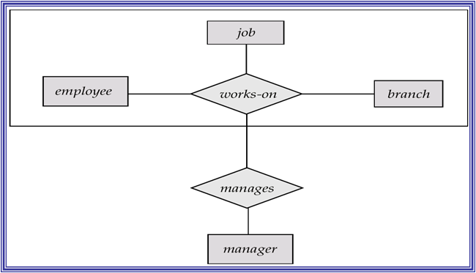
Aggregation

Slide 27
Problem
Construct an E-R diagram for a car-insurance company whose customers own one or more cars each. Each car has associated with it zero to any number of recorded accidents.

Slide 28
Problem
Construct an E-R diagram for a hospital with a set of patients and a set of medical doctors. Associate with each patient a log of the various tests and examinations conducted.

Slide 29
Problem
A large organization that does automobile repairs must keep track of its repair facilities or garages, the mechanics, and their qualifications in terms of the courses they have taken, the dates they took the courses, and the grade each earned for each course. Descriptions of these items are as follows:
•Garage: Garage’s identification number and manager’s name
•Mechanic: Employee number, name, DOB, age
•Course: Number, name, and duration (in weeks)
(a) What are the entities (fields) in this situation? What are the attributes of each entity?
(b) List the entities and their relationships to other entities or other attributes under one-to-one, one-to-many, many-to-many relationships.
(c)Describe this situation using an E-R model.

Slide 30
Tables from ER Diagram
Each entity and relationship becomes a table.
For an entity → attributes become the columns.
For a weak entity → columns include the primary key of identifying entity set and its own attributes.
For relationship → columns mean the primary keys of the participating entity sets and its own descriptive attribute, if any.

Slide 31
Tables from ER Diagram
Relationship joining strong entity and weak entity contains redundant data, no need to be expresses as table.
For composite attribute → instead of the attribute itself the sub attributes become columns in the table.
For multivalued attribute → separate tagble is maintained where the columns are the attribute and primary key. Each value is represented as a row.

Slide 32
Tables from ER Diagram
For aggregation → the table for relationship contains all the primary keys of the involved entity sets and its own descriptive attribute.
For generalization → create a table for higher level entity set and tables for each lower level entity set with columns for its attributes plus for the primary key of higher level entity set.
For generalization → if its disjoint and all attributes of higher level entity is in lower level entity. Create tables for lower level entity only and columns will be its attributes and each attribute of higher level entity.

Slide 33
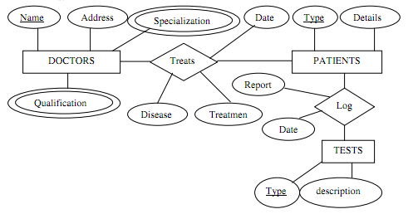
Design the tables for the following ER Diagram

Slide 34
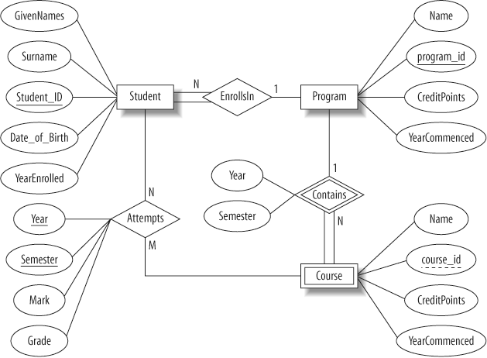
Design the tables for the following ER Diagram

